Slide 1
Lecture 18:
5.1. Western Europe, North America, and South America
Brad DeLong
Department of Economics & Blum Center, U.C. Berkeley; & WCEG
last revised: Mo 2020-03-26
for presentation: Tu 2020-03-31
Original course by Melissa Dell (Harvard Econ 1342), revised by Brad DeLong
<https://github.com/braddelong/public-files/blob/master/econ-135-lecture-18.pptx>
< https://www.icloud.com/keynote/0F9iiyQX0pkEnYMjqj3rIXhsQ>

Slide 2
Roadmap for the Next Two Weeks…
5. Touring the Continents
18. Th Apr 2: 5.1. Western Europe, North America, and South America
Read Before: Joel Mokyr (1990): Lever of Riches, chapter 10 Britain and Europe <https://delong.typepad.com/files/mokyr-lever-europe.pdf>
Read Before: John Coatsworth (2008).: Inequality, Institutions and Economic Growth in Latin America <https://delong.typepad.com/files/coatsworth-institutions.pdf>
Slides: <https://github.com/braddelong/public-files/blob/master/econ-135-lecture-18.pptx>
19. Tu Apr 7: 5.2. Behind the Iron Curtain, and East Asian Miracles
Read Before: Peter Evans (1995): Embedded Autonomy: States and Industrial Transformation, chapter 1 <https://delong.typepad.com/files/evans-embedded-i.pdf>
Read Before: Yingyi Qian (2001): How Reform Worked in China <https://delong.typepad.com/files/qian-reform.pdf>
Read Before: Richard Ericson (1991): The Classical Soviet-Type Economy: Nature of the System and Implications for Reform <https://delong.typepad.com/files/ericson-soviet.pdf>
Slides: <https://github.com/braddelong/public-files/blob/master/econ-135-lecture-19.pptx>
20. Th Apr 9: 5.3. Asia and Africa
Read Before: Nathan Nunn (2008): The Long Term Effects of Africa's Slave Trades <https://dash.harvard.edu/bitstream/handle/1/3710252/Nunn_Long-TermEffects.pdf>
Read After: Sevkut Pamuk (2014): Institutional Change and Economic Development in the Middle East, 700-1800 <https://delong.typepad.com/files/pamuk.pdf>
Slides: <https://github.com/braddelong/public-files/blob/master/econ-135-lecture-20.pptx>
6. Policy Issues
21. T Apr 14: 6.1. "Deep Roots" vs. Path Dependence
Read Before: Nathan Nunn (2012): Culture and the Historical Process <https://delong.typepad.com/files/nunn-culture.pdf>
Read After: Melissa Dell (2015): Path Dependence in Development: Evidence from the Mexican Revolution <https://scholar.harvard.edu/files/dell/files/revolutiondraft.pdf>
Slides: <https://github.com/braddelong/public-files/blob/master/econ-135-lecture-21.pptx>

Slide 3
Roadmap Following: 6. Policy Issues…
Th Apr 16: 6.2. Growth and Fluctuations; Trade and Development, Foreign Aid
Read After: Barry Eichengreen (2015): Hall of Mirrors: The Great Depression, The Great Recession, and the Uses-and Misuses-of History, selections <https://delong.typepad.com/files/eichengreen-mirrors.pdf>
Read After: David Atkin (2014): Endogenous Skill Acquisition and Export Manufacturing in Mexico <https://delong.typepad.com/files/atkin-skill.pdf>
T Apr 21: 6.3. Populism, Plutocracy, Kleptocracy, & Neo-Fascism
Read Before: Ernest Gellner (1973): Nations & Nationalism, selections <https://delong.typepad.com/files/gellner-nations.pdf>
Read Before: Barry Eichengreen (2018): The Populist Temptation Economic Grievance & Political Reaction in the Modern Era, selections <https://delong.typepad.com/files/eichengeeen-populist.pdf >
Th Apr 23: 6.4. Global Warming
Read After: Melissa Dell et al. (2012): Temperature Shocks & Economic Growth: Evidence from the Last Half Century <https://scholar.harvard.edu/files/dell/files/aej_temperature.pdf>
Read After: Melissa Dell et al. (2014). What Do We Learn from the Weather? The New Climate-Economy Literature, selections <https://economics.mit.edu/files/9138>
T Apr 28: 6.5. The Pace and Meaning of Economic Growth
Read Before: William Nordhaus: Do Real-Output and Real-Wage Measures Capture Reality? <https://www.nber.org/chapters/c6064.pdf>
Read Before: John Maynard Keynes: Economic Possibilities for Our Grandchildren<<https://delong.typepad.com/files/keynes-persuasion.pdf>
Read Before: Edward Bellamy (1887): Looking Backward 2000-1887, selections <https://delong.typepad.com/files/bellamy-backward.pdf>

Slide 4
Roadmap Following: 7. Conclusion…
7. Conclusion
Th Apr 30: 7. Conclusion: The Future?
Read After: Robert Allen (2011): Global Economic History: A Very Short Introduction, selections <https://delong.typepad.com/files/allen-geh.pdf >
W May 13 11:30-14:30: FINAL PAPER/PROJECT DUE

Slide 5

Coronavirus!

Slide 6

Coronavirus!

Slide 7
Discussion
Touring the Continents: Western Europe, North America, and South America
What strikes you as important here?

Slide 8

Touring the Continents: Western Europe, South America, & North America
Three discrete regions—or four, if you want to break off the southern cone of Latin America:
Two do very well indeed:
Western Europe converges to the world’s productivity frontier
America surpasses what had been thought to be the world’s technological and industrial pace cars—Britain and Germany—to become the “furnace where the future is forged”
Latin America does not do well
Even with favorable resource-to-population ratios
“Extractive institutions”: How created? How maintained? Why the very long shadow of history?
The puzzle of the southern cone of South America: many explanations that work for tropical economies do not work to explain its failure to catch up and convert
1:15
Notes:
Now it is time to start our tour of the continents.
Let's start with the North Atlantic plus the western shore of the South Atlantic—with Western Europe, South America, and North America. They make up three discrete regions. Or, perhaps, four discrete regions, if you want to break off the southern cone of South America from the rest of Latin America
Two of these regions do very well indeed, All of western Europe converges to the world's productivity frontier. North America surpasses what had been thought to be the world's technological and industrial pace cars, Britain and Germany, to become “the furnace where the future is forged” from around 1870 to 2016.
Latin America by contrast, does not do well. It has favorable resource to population ratios. yet it fails to converge to the world's productivity frontier.
Why doesn't it? Well, we say “extractive institutions”. But that is just a label. How were they created? How maintained? Why the very long shadow of history? Plus there is the puzzle of the southern cone of South America. It too has failed to converge to the global North norm. Yet many explanations that work for “tropical” economies’ relative poverty today do not work for the southern cone—do not explain its failure to catch up and converge

Slide 9
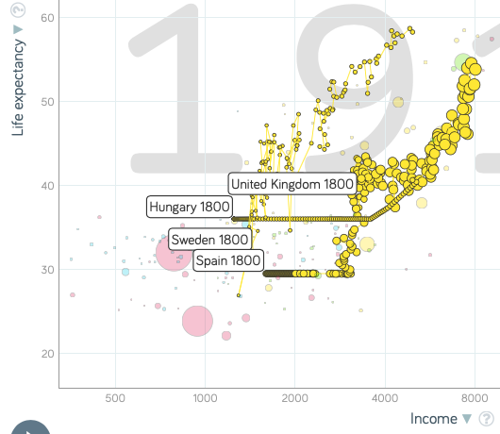
Western Europe, 1800-1914
Spread of incomes of 2.5-1 in 1800:
Spread of incomes of 2.5-1 in 1914
No signs of catch-up within western Europe
But also no signs of divergence either
As if political institutions impelled constant relative income levels
Save for Sweden among these four
Which becomes much more democratic and open
And which does converge
Cause or effect
1:15
Notes:
From 1800 to 1914, within western and central Europe, our spread of per capita income levels is constant. We have a spread of 2.5-1 in 1800. We have a spread of incomes of 2.5-1 in 1914. There are no signs of catchup and convergence within western and central Europe. But also there are no signs of divergence. That nonexistence of divergence makes western Europe an extraordinary region in the context of the years 1800-1914. Most everywhere—in othe regions and over the globe as a whole—there is substantial divergence.
Western Europe is the exception. It is as if divergences in political institutions maintained themselves, and so impelled constant relative income levels.
Look at the four countries plotted here: teh United Kingdom, Spain, Sweden, and Hungary. The U.K., Spain, and Hungary grow in parallel. Sweden transitions—from closer to Spain in 1800 to closer to Britain in 1914. Sweden manages to transition itself from being a relatively poor Western European country to being a relatively rich one. As it transitions, it becomes much more democratic and open.
It does converge to the world industrial leader norm. Cause or effect of democraticzation, mass education, and more secure property rights? Almost surely both. How much cause and how much effect? That is a deep question that I do not think we have a terribly good answer to. But we can at least look at the tea leaves.

Slide 10
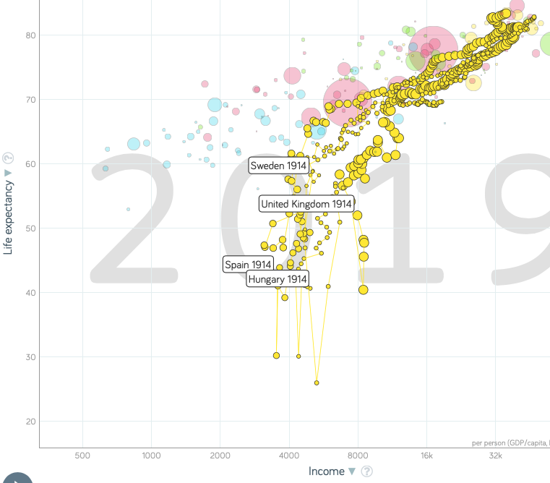
Western Europe, 1914-2020
Spread 3-2 by 2020:
Hungarian catchup after 1990
Spanish catchup after 1975
Political democracy
Mixed (market heavy) economy
Strong convergence as institutions—political and economic—converge
Hungary now a dictatorship—it will be interesting to see what happens next
1:30
Notes:
Western Europe from 1914 to 2020 sees a different pattern: catchup and convergence. The income spread drops from 2.5-1 to 1.5-1. Those countries that do badly during part of the period—Hungary behind the Iron Curtain from 1945-1990, Spain under fascist rule 1936-1975—catchup substantially once their peculiar institutions are dissolved and they reapproch the western european norm.
What is that western European norm? Since the founding of NATO and the implementation of U.S post-WWii aid in the form of the Marshall Plan with its associated conditionality demands that countries establish market-friendly mixed economies, the norm has been social democracy: political democracy, a mixed economy, indicative planning, mass education, and other forms of social insurance. Their has been very strong convergence in institutions. And there has been very strong economic convergence as well.
We describe this as converge to “developmental institutions”. But that's just a label describing the existence of a thing. It is not a description of the thing—not a description that is of much use in assisting other countries to insert the key in the lock and so open the door.
Moreover, the penalties of having had “extractive” institiutons in the past still seem to matter. Hungary is now a dictatorship. It will be interesting to see what happens next. It will be sad as well. Hungary is now a dictatorship because it was unfortunate enough to have 45 years of extractive institutions from 1945 to 1990 under communism. Even a generation later, the impact is still there.

Slide 11
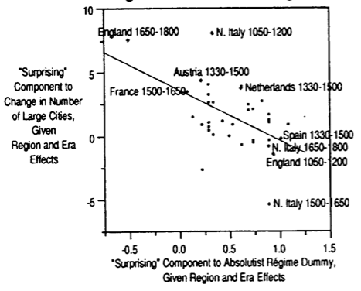
We Can See This, Earlier, in Princes & Merchants
Importance of régime type even in agrarian & feudal eras:
DeLong & Shleifer:
“The total population living in western European cities of 30,000 or more in 1650 was 4.7 million. Had each of the nine regions experienced an additional century and a half of absolutist rule before 1650, this urban population would have been reduced by two million…
“Conversely, had all of western Europe been free of absolutist rule over 1050–1650, then the regression in line 1 of table 3 predicts that Europe in 1650 would have had a total urban population of nearly 8 million…”
How did western Europe establish democracy—and avoid central planning/aristocratic rent-seeking?
1:00
Notes:
We have seen this earlier. We have seen the importance of regime type in Europe, even in the agrarian and in feudal eras. Recall that we read an article by me and my freshman roommate Andrei Schleifer in which we concluded that institutions mattered bigtime, at least in Europe:
>The total population living in western European cities of 30,000 or more in 1650 was 4.7 million. Had each of the nine regions experienced an additional century and a half of absolutist rule before 1650, this urban population would have been reduced by two million…
>Conversely, had all of western Europe been free of absolutist rule over 1050–1650, then the regression in line 1 of table 3 predicts that Europe in 1650 would have had a total urban population of nearly 8 million…
How did Western Europe established democracy and avoid both central planning and aristocratic rent thinking? That is a long historical story which we will now tell a little bit of.

Slide 12
Virtuous Circles
Western European institutions—until the 1920s—moved only forward, never backward:
Needed endpoint:
secure property rights and a level playing field
political power constrained and distributed
far fewer rents from holding power
fewer power struggles & greater stability
Franchise extension
To draw the fangs of revolution
To boost your share of the vote
Because it was the right thing to do to create a strong & prosperous nation
Bismarckian socialism in Germany…
1:30
Notes:
The most striking thing about Western Europe is how its institutions revolve in virtuous circles. Up until after World War I, they go always forward, never backward.
It appears to be what was needed for prosperity was secure property rights and a level playing field, with political power constrained and distributed. Then tthere would be far fewer rents from holding power. Then there would be fewer power struggles and greater stability. Then there would be more energy devoted to entrepreneurship and enterprise. Then there would be a lot less energy on the parts of entrepreneurs and enterprisers devoted to trying to protect their political flanks from rent seeking and expropriation
As history advances in time, and western Europe develops, we see the political base of the population getting wider and wider. The population becomes more educated. As more people acquire the potential for political agency, we see franchise extension: more people both allowed to vote and who grab the vote by threatening upheaval if they do not take it.
Elites agree. Sometimes elites agree to draw the fangs of revolution. Sometimes to boost their share of the vote for a freagment of the elite that thought it would benefit from having a larger electorate.
Sometimes elites acquiesced because it was the right thing to do.
Sometimes elites acquiesced in order to create a strong and prosperous nation. Look at Bismarckian socialism in Germany in the late 1800s.

Slide 13
Bismarckian Socialism
Germany, 1884, Reichstag Speech on the Law for Workers’ Compensation:
“Does the state have the responsibility to care for its helpless fellow citizens, or does it not? I maintain that it does have this duty…. Those goals that the community can fulfill with justice and profit should be relinquished to the community… the help of persons in distress and the prevention of such justified complaints as in fact provide excellent material for exploitation by the Social Democrats.
“That is the responsibility of the state from which the state will not be able to withdraw in the long run.
“If one argues against my position that this is ‘socialism', then I do not fear that at all.
“The question is, where do the justifiable limits of state socialism lie?… Each law for poor relief is socialism….
“I remind you of France… the remarkable social politician, Léon Say*… expresses the French view that every French citizen has the right to starve, and that the state has no responsibility to hinder him in the exercise of his right…”
*Grandson of Jean-Baptiste Say
1:45
Notes:
Look at Otto von Bismarck, first chancellor of the German empire established in 1871. The German empire established by war. Otto von Bismarck, militarist and authoritarian, best known for his speech in 1848 that democrats and parliamentarians were silly: “for it is not by speeches and majority votes that the great issues of the day will be decided, but by blood and iron”.
Yet here is Otto on Bismarck as chancellor in 1884, giving a speech before the German empires parliament, the Reichstag, on the law for worker's compensation that he is trying to push through parliament:
>Does the state have the responsibility to care for its helpless fellow citizens, or does it not? I maintain that it does have this duty…. Those goals that the community can fulfill with justice and profit should be relinquished to the community… the help of persons in distress and the prevention of such justified complaints as in fact provide excellent material for exploitation by the Social Democrats.
>That is the responsibility of the state from which the state will not be able to withdraw in the long run.
>f one argues against my position that this is ‘socialism', then I do not fear that at all.
>The question is, where do the justifiable limits of state socialism lie?… Each law for poor relief is socialism….
“I remind you of France… the remarkable social politician, Léon Say*… expresses the French view that every French citizen has the right to starve, and that the state has no responsibility to hinder him in the exercise of his right…

Slide 14
Why Not Repression?
Sometimes the answer is repression:
Especially when the rich can find a charismatic rabble-rouser who they think can serve as their frontman: cf. Germany, 1933; Italy, 1921…
Dell cites: Acemoglu & Robinson:
A shock that momentarily raises the power of the poor
The rich can:
promise a less unequal distribution in the future
share power via franchise extension
repress
(1) is not credible
First Lord of the Treasury Earl Grey on the Great Reform Bill of 1831:
“There is no-one more decided against annual parliament[ary elections], universal suffrage and the [secret] ballot than I am. My object is not to favor, but to put an end to such hopes and projects ... The principal of my reform is to prevent the necessity of revolution ... reforming to preserve and not to overthrow…”
2:00
Notes:
But why did western European elites, during the long march from 1620 to today of poiltical democratization, engage in franchise extension and in negotiation rather than in repression?
Well, sometimes the answer was repression—especially when the rich good could find a charismatic rabble rouser who they thought could serve as their frontman, most prominently in Germany in 1933 with the rise of Adolf Hitler and the Nazis, and in Italy in 1921 with the rise of Mussolini and the Italian fascists. And there are reactions earlier as well.
Melissa Dell cites Daron Acemoglu and James Robinson’s thoughts about what happens in the event of a political shock that momentarily raises the power of the poor. In response, the rich can:
1. promise a less unequal distribution in the future
2. share power via franchise extension
3. repress
If they repress, they had better hope that repression is successful, that it does not lead to revolution. For then they lose everything.
(1) is simply not credible.
So sometimes—and often enough for it to matter for the great sweep of history—they chose (2). When repression seems too risky, then to sharing power via franchise extension is a way to try to calm down the system and prevent there from being chaos. Witness Britain’s First Lord of the Treasury Earl Grey on the Great Reform Bill of 1831:
>There is no-one more decided against annual parliament[ary elections], universal suffrage and the [secret] ballot than I am. My object is not to favor, but to put an end to such hopes and projects ... The principal of my reform is to prevent the necessity of revolution ... reforming to preserve and not to overthrow…

Slide 15
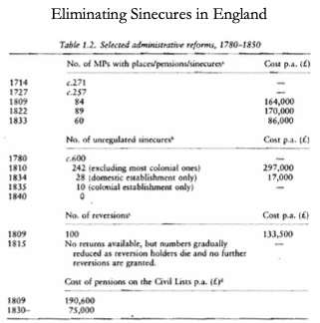
Eliminating Sinecures & Advancing Good Government
Western European elites were subject—relatively & also absolutely—to being creatively destroyed:
But they responded not by trying to repress opponents and retract pluralism
They responded by further liberalizing the system
In some places, change was more radical:
France became the first country to adopt universal male suffrage, in 1792
France was one of the last Western Europe countries to grant women the right to vote, in 1944
2:00
Notes:
Western European elites did fear revolution and change. They were subject, relatively and also absolutely, to being creatively destroyed. But their response was more often than not to eschew repressing their opponents. Rather, it was by trying to figure out a way to work change to their advantage—coopting some into the power structure by further liberalizing the system, hoping to produce other bases of power than simply force, law, and history.
They were the rich. They were in an environment in which they were the rich and they were facing demands for income redistribution and more opportunity on the part of the poor.
Perhaps they could assemble a ruling coalition by focusing on some other potential societal cleavages and bases of The nation against the nation’s enemies? The religious against the ot so religious? Order and things-as-they-were against anarchy and change? Issues on which they would have a majority of the electorate on their side?
And of course in some places there was revolution—and then change became more radical. And that made elites fearful of trying to put your finger in the dike to hold back the flood. If the flood was not channeled, it would overwhelm—as the French aristocracy had been overwhelmed in the Great French Revolution.
That was when France became the first country to adopt universal male suffrage in 1792. It served as an example of what others might fear, and why they should be gladly offering more minor franchise extensions.
(Curiously, France was also one of the very last year Western European countries to grant women the right to vote, waiting until 1944 and its liberation from the Nazis to do so.)

Slide 16
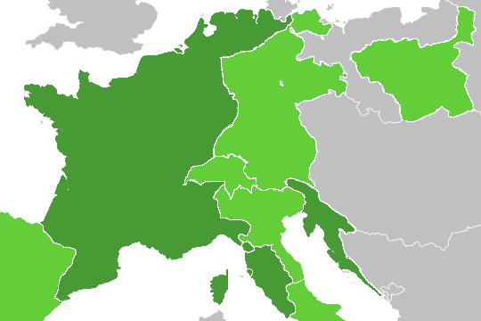
The Legacy of the French Revolution & Napoleon’s Conquests
Acemoglu, Cantoni, Johnson, & Robinson use the variation within present day Germany as a result of French rule in the Napoleonic era:
More institutional reforms
Guilds were more likely to be abolished
Civil legal code more likely to be implemented.
Faster urbanization, which ACJR use as a proxy for economic growth.
ACJR argue that the imposition of French institutions in some places but not others was exogenous to growth potential:
France decided where to conquer based primarily on military concerns
ACJR claim we can interpret these estimates as causal evidence that institutional reform promoted growth
Regression discontinuity, yes; but among those “military concerns” is “was it close to France?”
2:45
Notes:
Can we tell much about whether franchise extension and political liberalization—establishment of a level playing field, secure property rights, and rules of the game that made all equal (as opposed to making some aristocrats more equal than others)—whether that was the cause of rapid economic growth or the consequence? Acemoglu, Cantoni, Johnson, & Robinson use the variation within present day Germany as a result of French rule in the Napoleonic era to try to find out. They think the legacy of the spread of the French Revolution and its institutions via Napoleon's conquests from 1800-1815 gives them a clue.
In the map ver on the right, the dark green shows the areas that were annexed to the French empire under Napoleon between 1804 and 1815. These were the areas that introduced modern French institutions. Guilds were more likely to be disestablished. Equality under the law was imposed. A written civil legal code was adopted. And in those dark green parts of Germany, we see faster economic growth thereafter. (This is also the case for Tuscany and Latium vis-a-vis elsewhere in Italy. This is also the case in Dalmatia over on the other side of the Adriatic).
We do see faster economic growth in the Rhineland and in North Germany around Hamburg. near the North sea. ACJR argue that the imposition of French institutions in some places but not others was exogenous to what the potential for economic growth was. France decided where to conquer via a military logic. Thus they interpret all of this correlation as a causal chain running from institutions to growth.
That institutional reform was the cause and growth was largely the effect I agree. But all? Yes, there is a discontinuity where the French conquered. But I do not believe that military concerns were unconnected to growth potential. Thus I don't think the evidence they presented is as strong as they think it is. France conquered regions close to France, with good transporation networks. Those are related to growth potential, as well as satisfying the military logic.

Slide 17
Reaction in Eastern Europe Pre-1939
Alexander Gerschenkron: Europe in the Russian Mirror: Four Lectures in Economic History:
“Economic progress began to be viewed with great suspicion and the railroads came to be regarded, not as welcome carriers of goods and persons, but as carriers of the dreaded revolution. Then the State clearly became an obstacle to the economic development of the country…
Cf.: Jerome Blum: Transportation and Industry in Austria, 1815-1848:
“These living forces of the traditional economic system were the greatest barrier to development. Their chief supporter was ... Emperor Francis. He knew that the advances in the techniques of production threatened the life of the old order of which he was so determined a protector. Because of his unique position as final arbiter of all proposals for change he could stem the flood for a time. Thus when plans for the construction of a steam railroad were put before him, he refused to give consent to their execution ‘lest revolution might come into the country’…”
Eastern European elites saw what was happening in the West, and recognized that structural change could cause them to lose power
As opposed to: “if things are to stay the same, everything must change…” Il Gattopardo
2:00
Notes:
By contrast, in eastern Europe and sometimes in central and Southern Europe as well, we see elites that are much less eager to compromise and much more eager to repress.d My teachers’ teacher Alexander Gerschenkron on Russia, in his Europe in the Russian Mirror: Four Lectures in Economic History:
>Economic progress began to be viewed with great suspicion and the railroads came to be regarded, not as welcome carriers of goods and persons, but as carriers of the dreaded revolution. Then the State clearly became an obstacle to the economic development of the country…
Jerome Blum points to early 19th century Austria, before 1848:
>These living forces of the traditional economic system were the greatest barrier to development. Their chief supporter was ... Emperor Francis. He knew that the advances in the techniques of production threatened the life of the old order of which he was so determined a protector. Because of his unique position as final arbiter of all proposals for change he could stem the flood for a time. Thus when plans for the construction of a steam railroad were put before him, he refused to give consent to their execution ‘lest revolution might come into the country’…
Eastern European elite saw what was happening in the West. They recognized that structural change could cause them to lose their power. They did not want to be creatively destroyed by change. And so they tried to freeze things.
This is opposed to the view that “if things are to stay the same, then everything must change”, that we see laid out in the 19th century novel I Gattopardo, which described the reaction of elites in the bulk of Western Europe. Western European elites tried to ride the wave—spent time trying to figure out how to deal with the changes that technology and democracy were bringing to the world. Eastern European elites did not: poverty, income gaps, fascism, revolution, and communism were the result.

Slide 18
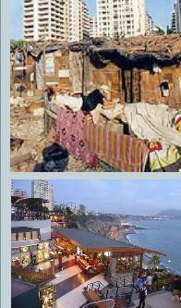
The Great Divergence in the Americas
Popular wisdom emphasizes high rates of inequality and poverty in Latin America:
In Latin America, between-municipality differences are twice between-country differences
(the reverse if the United States is included in the sample)
Causes of differences:
Historical institutions
Historical inequality
Geographic/ecological factors (climate)
􏰂Education explains half
What about the rest?
Other public goods?
Geography?
2:30
Notes:
And then there is the great divergence in Latin America. The failure to converge in Latin America, independent from the 1820s, not ruled by colonialists, at least formally democratic, is distressing and puzling to economists.
The formal institutions of the state are republican from the 1820s on. Yet Latin America fell and remains far behind the global North norm in terms of prosperity today.
Popular wisdom emphasizes high rates of inequality and poverty in Latin America. The stakes of politics are higher and the tools used sharper because the elites are richer and feel that they have more to lose by creative destruction from economic change. And because the poor are poor, they are unable to find the resources to educate themselves and become more productive. Yet the situation is complicated. Things matter at a detailed level. Latin America is not a monolith: For example, between-municipality differences are twice as large as between-country differences. It's not so much that Latin American countries are poorer than others. It’s that some regions are much poorer than others. And few regions are very rich. So national -evel institutions cannot play a huge and exclusive role.
Yet, of course, comparing Latin America as a whole to the global North, the gap remains huge even between even the richer portions of Latin America and the global north in large part of nation-level institutional differences.
What are the causes of these differences in prosperity, both comparing Latin America as a whole to the north Atlantic and within Latin America? Historical institutions? Historical inequality. Some people stress geographic and ecological factors.
General education levels explain about half of Latin American divergence both within Latin America and compared to the rest of the world. But what accounts for the rest? Where does it come from? Does it come from institutions? Does it come from the failure to provide other public goods besides education? Does it come from geography?
Let's see what we can try to establish.

Slide 19
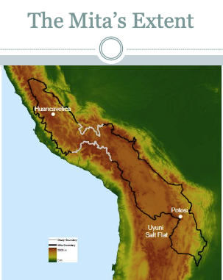
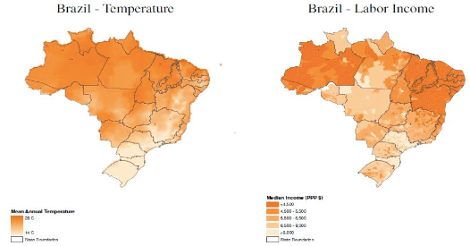
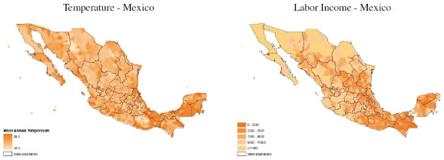
Some Maps
2:00
Notes:
Let's start with some maps. Here we see one institutions map and two geography maps.
Here on the left we see Peru, and the boundaries of the “mita”, an institution introduced under Spanish rule to extract a forced labor force to staff the silver mines at Potosi, which was one of the major sources of Spain's wealth from the exploitation of the the American colonies back when Spain ruled the area region. The silver would not extract itself. And so societies were thrown into turmoil and upheaval as large amounts of men were pulled away from their homes and instead sent into near-slave labor in the mines. That turmoil had impacts on local public economy. “Miita” regions even today appear to be much poorer than those surrounding.
Then we have Brazil, with the hot and wet Northeast settled early by Portuguese poor and devlted to primary product production: sugar cane, coffee, and so forth. Brazil’s south is much more like the southern cone of Latin America. It was settled later. it is more temperate. It is much richer, much more industrialized, much more prosperous, and also cooler. In Mexico as well we see a substantial temperature-humidity-prosperity gradient. It is the Yucatan and the south that are the places in Mexico that are the poorest and the wettest and the hottest, compared at least to the central Valley and central plateau of Mexico.

Slide 20
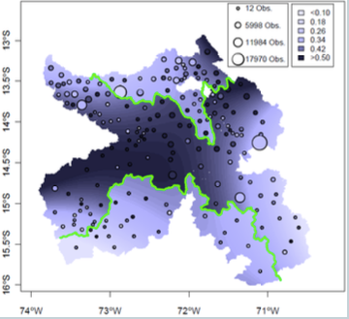
Pitosi and the Mita
A forced labor system to supply the silver mines:
Mita communities 25% poorer today…
Channels
Few large landowners in mita districts—but this meant no property rights at all
Public goods: fewer roads, lower education
􏰂Interruption of careers meant mita residents were subsistence farmers
The remarkable and screwy things is that these effects persist
Edgar Gonzales:
“It􏰄’􏰅s certainly not geography, it’s government… some p􏰉rovinces􏰊􏰅 have been favored, with the government—particularly during the large road building campaign in the early 1950’s—choosing to construct roads in some provinces and completely ignore others…’’
Regression discontinuity…
2:15
Notes:
As Melissa Dell points out, the historical marks left on Peruvian prosperity today by the silver mines at Potosi and the “mita” forced labor system are quite remarkable and quite apparent. If you were subject to the “mita”, your communities are 25% Porter today. You have fewer roads and lower education levels. You receive fewer public goods. The interruption of livelihoods for the labor draft meant that “mita” re residents became and remain subsistence farmers rather than getting educated and moveing into crafts. And you had few large landowners in “mita” districts—if you were constantly being drafted off and sent to the mines, it was a very difficult to accumulate property. But the lack of accumulated property in the hands of the rich did not mean lots of stable small farms. It did not mean secure property rights. It rather meant, rather, no property rights at all: There was no one with enough wealth and enough of a backing and enough of a clientele to make their claims to property stick against the central government.
The remarkable and screwy thing is that these effects persist, that what happened centuries ago seems to influence how political economy works today. How much the Peruvian government with the workings of its bureaucracy is willing to support and encourage growth in different regions is, at a very granular level, highly correlated with the social historical imprint of the “mita”.
As Edgar Gonzalez put it:
>It􏰄’􏰅s certainly not geography, it’s government… some p􏰉rovinces􏰊􏰅 have been favored, with the government—particularly during the large road building campaign in the early 1950’s—choosing to construct roads in some provinces and completely ignore others…
This regression discontinuit at the borders of the “mita” is visible and impressive. It is a sign of how much history is, in fact, a series of butterfly wingflap accidents, with small changes in the distant past sometimes having very large changes in the way things work on the ground today.

Slide 21
Reversal of Fortune in the Americas
Arthur Young: Political Essays Concerning the Present State of the British Empire:
“It appears on the whole, that the staple productions of our colonies decrease in value in proportion to their distance from the sun. In the West Indies, which are the hottest of all, they make to the amount of 81£.12s.1d per head... In the northern settlements, to that of 2s. 6d. This scale surely suggests a most important lesson—to avoid colonizing in northern lands…”
After 1800 the United States industrialized and grew rapidly. By 1910 it was the richest country in the World and it sustained this achievement throughout the 20th century.
After independence, many Latin American countries, for instance Mexico, underwent sustained economic decline, while others, such as Brazil and Colombia, experienced stagnation:
Life expectancy in Latin America in 1900 was around 60% of the level in the United States
Transitory catch-up: Brazil in the 1960s, Venezuela between the 1930s and 1960s, or Chile since 1985.
Sustained divergence: Argentina after the 1920s and Venezuela since 1980.
2:15
Notes:
We thus see that have a rather stunning reversal of fortune in the Americans over the past three centuries.
As British commentator, journalist, intellectual and farm expert Arthur Young put it in his Political Essays Concerning the Present State of the British Empire:
>It appears on the whole, that the staple productions of our colonies decrease in value in proportion to their distance from the sun. In the West Indies, which are the hottest of all, they make to the amount of 81£.12s.1d per head... In the northern settlements, to that of 2s. 6d. This scale surely suggests a most important lesson—to avoid colonizing in northern lands…
But those Northern lands—New England and the province of Ontario in Canada—are now the richest in the world, Arthur Young was very, very wrong. Things changed after 1800. The United States and also Canada industrialized and grew rapidly. By 1910 they were the richest regions in the world. They sustained that achievement throughout the 20th century.
By contrast, after independence many Latin American countries underwent sustained economic decline: Mexico. Others suffered stagnation: Brazil and Colombia. Life expectancy in Latin America went from being equal to that in North America in 1700 to around 60% of the level of the United States in 1900
There were transitory catchups: Brazil in the 1960s ,Venezuela between the 1930s and 1960s, Chile since 1985.
There also have been examples of sustained divergence. Argentina was prosperous in 1920. Back then it looked a lot like New Zealand or Australia or even Canada. But since the 1920s, Argentina has been on a downward sustained downward relative spiral.
Venezuela, recently, has been worse. It has been on a remarkably rapid downward relative spiral with respect to the global north since 1980

Slide 22
Iron Law of Oligarchy
German sociologist Robert Michels: The Iron Law of Oligarchy:
‘Society cannot exist without a “dominant” or “political” class, and that ruling class, while its elements are subject to frequent partial renewal, nevertheless constitutes the only factor of sufficiently durable efficacy in the history of human development.
‘The government, or, .. the state, cannot be anything other than the organization of a minority. It is the aim of this minority to impose upon the rest of society a “legal order” which is the outcome of the exigencies of dominion and of the exploitation of the mass…. Even when the discontent of the masses culminates in a successful attempt to deprive the bourgeoisie of power, this is... effected only in appearance; always and necessarily there springs from the masses a new organized minority which raises itself to the rank of a governing class…”
Latin America:
For idiosyncratic reasons, tied to the nature and distribution of pre-colonial societies 500 years ago (which don’t have a lot to do with what causes economic growth today), and the ability to use slave labor, Latin America ended up with extractive economic and political institutions which created poverty and inequality
The influence of these have persisted over time, despite definite gains in terms of income per-capita, education, life expectancy and even political rights like democracy
Even after Latin American economies started go grow in the 1870s-1880s they never managed to close the relative gap with the US
Colombia was 18% of US GDP per-capita in 1900 and 100 years later it was.... 18% of GDP per-capita
4:30
Notes:
The importance of chance, of luck, of a particular setup that gives you bad institutions by giving you too-unequal a distribution of income and too-dominant an oligarchy at the start. The long and very dark shadow cast by such things down the centuries in terms of “extractive” rather than “developmental” institutions.
How are we to understand this?
I think this is best understood by going to German sociologist, Robert Michels and his Iron Law of Oligarchy: the general rule that 80% of the stuff is grabbed by 20% of the people. Yes, umans are friendly gift exchange animals. Yes, humans are empathic animals. But humans are also animals that to some degree like there to be a dominance hierarchy.
As Michels put it, the elite can change—a partial or total circulation or replacement—but a power elite of some sort will remain. A good society will have a stable elite interested in win-win cooperation. A bad society will have an unstable elite fearful of its place focusing on win-lose exploitation.
As Michel put it:
>Society cannot exist without a “dominant” or “political” class, and that ruling class, while its elements are subject to frequent partial renewal, nevertheless constitutes the only factor of sufficiently durable efficacy in the history of human development.
‘
>The government, or… the state, cannot be anything other than the organization of a minority. It is the aim of this minority to impose upon the rest of society a “legal order” which is the outcome of the exigencies of dominion and of the exploitation of the mass…. Even when the discontent of the masses culminates in a successful attempt to deprive the bourgeoisie of power, this is... effected only in appearance; always and necessarily there springs from the masses a new organized minority which raises itself to the rank of a governing class…
We see this, of course, most impressively in Russia and in China, Russia and China go through the most unbelievable and prolonged revolutionary processes throughout the years of the 1900s. Yet Russia started out with a czar: Nicholas II Romanov. Russia ends with a Czar: Vladimir Putin. China started out with a court: the late Qing dominted by Cixi of the Ching dynasty, China ends with a court—this time dominated by Xi Jinping.
The question is, rather, how powerful are the institutions that provide voice and that provide a check on the exploitation of the mass by the elite? A situation in which the elite exploit less is one in which there's an opportunity to train the elite that developmental institutions, while they may make its relative dominance much less strong, do make for a better and a wealthier society. Few in America's power elite would change their positions for those of Russia’s today.
And that matters.
By contrast, in Latin America, even today, too much of the elite fear, the consequences for themselves of failing to maintain a strong repressive hand. That is because they anticipate that they, should revolution come, should repression fail, will not stay on top afterwards. Their segment of the elite will be replaced by another elite. Very little of Cuba's elite in the 1950s was its elite under Fidel Castro in the 1960s and 1970s. It was a different elite—although still an elite.
Hence the fight tooth and nail to prevent sufficient change to threaten revolution. That plus the fact that the life of an exploiterunder extractive institutions is a relatively cushy one evenIf you do not have managed formal education or much productive skills—that seems to explain a bunch of Latin America's relative decline at a fairly deep and fundamental historical level.

Slide 23
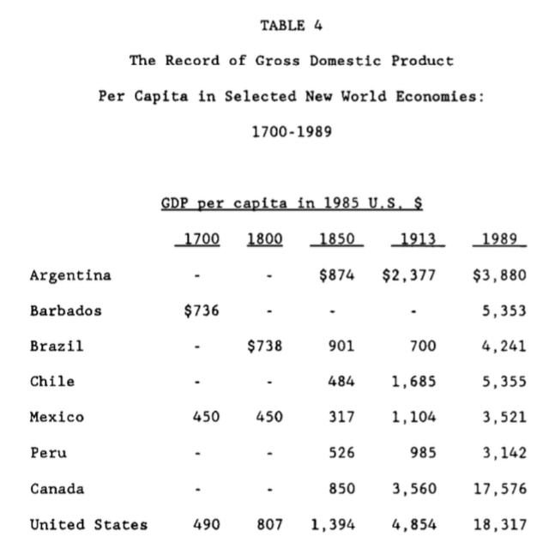
Engerman and Sokoloff: Very Long Run Consequences of Being Ruled by Slave- or Serf-Masters
Different labor systems as the result of the luck of history and “factor endowments”
How do you establish an unfree labor system?
How do you maintain an unfree labor system?
What does having an unfree labor system do to elite incentives?
Does the elite control the economy? If so, does it control it in its long-run interest?
1:30
Notes:
Thus we have what Engerman and Sokoloff see as very long historical consequences of having been ruled by slave masters. We can see today the imprint on modern societies Latin America's history back centuries and centuries ago.
The different labor systems established in the colonial era as the result of the luck of history and factor endowments leave their legacy. Where it was most profitable to establish unfree labor systems, they were established.
How do you establish an unfree labor system? Through domination. How do you maintain an unfree labor system? Through domination? What does having an unfree labor system due to elite incentives? It creates an elite focused on domination, rather than an elite focused on developing resources in cooperation with others.
Does the elite control the economy by and large? Yes. If so, does it control it in its own long run interests? The answer is that an elite that sees itself as exploitative is going to be much less interested in education, in infrastructure, in anything other than maximizing the amount of surplus extracted in the short run. And that focus is not even in the elite’s interests if we look at it as a boy echoing down the generations.
And so we see the great reversal of fortune between Latin America and North America between 1700 and today.

Slide 24
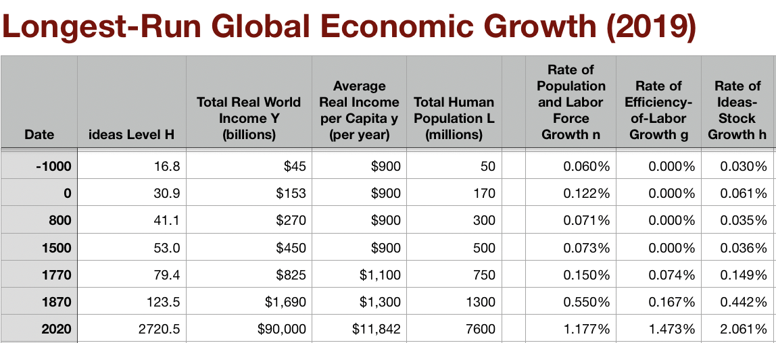
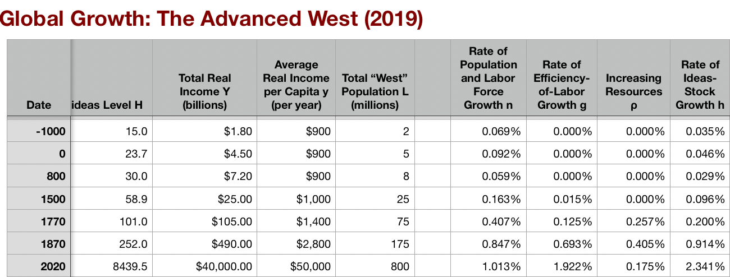
North American Ascendancy
From Carl Sandburg: Chicago (1916)
Hog Butcher for the World, Tool Maker, Stacker of Wheat, Player with Railroads and the Nation's Freight Handler; Stormy, husky, brawling, City of the Big Shoulders: They tell me you are wicked and I believe them, for I have seen your painted women under the gas lamps luring the farm boys. And they tell me you are crooked and I answer: Yes, it is true I have seen the gunman kill and go free to kill again. And they tell me you are brutal and my reply is: On the faces of women and children I have seen the marks of wanton hunger And having answered so I turn once more to those who sneer at this my city, and I give them back the sneer and say to them: Come and show me another city with lifted head singing so proud to be alive and coarse and strong and cunning…. Laughing the stormy, husky, brawling laughter of Youth, half- naked, sweating, proud to be Hog Butcher, Tool Maker, Stacker of Wheat, Player with Railroads and Freight Handler to the Nation.
0:45
Notes:
This slide is a reminder that American economic ascendancy and the ascendancy of the global north more generally is one of the most extraordinary features of all of modern economic history. Such divergence and exceptionalism in a world that is as small in transport and communications and ideas! How can that environment be consistent with such huge divergence in terms of income and wealth?
I also present a poem from Carl Sandburg, Chicago, celebrating the exuberant industrialization and culture of that Midwestern metropolis. Read it. It's fun. Better yet, find a skilled poetry reciter to read it to you. It's better:
From Carl Sandburg, “Chicago” (1916):
Hog Butcher for the World,
Tool Maker, Stacker of Wheat,
Player with Railroads and the Nation's Freight Handler;
Stormy, husky, brawling,
City of the Big Shoulders:
They tell me you are wicked and I believe them, for I have seen your painted women under the gas lamps luring the farm boys.
And they tell me you are crooked and I answer: Yes, it is true I have seen the gunman kill and go free to kill again.
And they tell me you are brutal and my reply is: On the faces of women and children I have seen the marks of wanton hunger.
And having answered so I turn once more to those who sneer at this my city, and I give them back the sneer and say to them:
Come and show me another city with lifted head singing so proud to be alive and coarse and strong and cunning….
Laughing the stormy, husky, brawling laughter of Youth, half-naked, sweating, proud to be Hog Butcher, Tool Maker, Stacker of Wheat, Player with Railroads and Freight Handler to the Nation.

Slide 25
The 1870 Growth Inflection Point
Growth in global living standards 1870-1914 came largely as a surprise:
Over 1870-1914, year by year, real wages rose across the globe
Structural transformation
The diffusion of industrial technologies—to Des Moines IO & Birmingham AL, but also to Vienna, Cracow, and Barcelona
And demand from the growing industrial North Atlantic core for “tropical” commodities
Five factors in play:
Invention of invention: industrial research lab
Routinization and bureaucratization of technology diffusion: the modern corporation
Globalization
In goods trade
In communication
In migration
Fair to say this half-century was not foreseen, and was viewed at the time and in retrospect as miraculous. (Cf.: Keynes, Economic Consequences of the Peace.)
2:40
Notes:
In the world’s North Atlantic region every year between 1870 and 1914 saw populations rise; agricultural labor productivity improve; farmers pushed out of agriculture where they were no longer needed and pulled into mining, manufacturing, and urban services where they were; and technology diffuse as people in Des Moines, Iowa and Birmingham, Alabama but also Vienna, Cracow, and Barcelona learned how to apply the industrial technologies invented in Manchester, London, Liege, and Lowell, Massachusetts. Most important, every year between 1870 and 1914 saw newer and better industrial technologies emerge from the first industrial research laboratories ever.
Pre-World War I patterns of growth are, I think, beset read as the working-out of the economic, political, and technological logic of the—relatively sudden, around 1870—creation of the first true global economy. Starting from a still largely very poor and overwhelmingly pre-industrial world, by the late nineteenth century transportation costs had finally fallen low enough and transport speeds had become high enough to make mass intercontinental shipment of goods and people possible. Moreover, communications had improved to such a degree that the world truly became one world in that you could wrap a single organization across the globe and expect it to work. Thus these improvements in transportation and communication had for the first time created the possibility of a global economy—an economy in which movements of people and goods across oceans and between continents were central to how the economy worked, rather than mere precious and luxury froth on the surface of a deep ocean. Combine those with the invention of invention—the coming of science to technology—and we have the pre-World War I world, in the North Atlantic, at least.
This by and large came as a surprise. Indeed, it is fair to say that as of 1870 the idea that modern economic growth would take hold and grip the world was still a fringe, utopian one—more-or-less confined to dreamers and socialists, and not even all of them.

Slide 26
The Industrial Revolution Did Not Light Off the Rocket
Key was that the British Industrial Revolution led to the invention of invention
The technologies of steam, textile machinery, ironworking, & railroads were great
They were not transformative
World in 1870 still desperately poor
Not at all clear world in 1870 would see technology outrun fecundity
Any slowdown in further technological development would return humanity to its Malthusian prison
And there had been other largely-local “efflorescences” before that had ended in jumps in population rather than in living standards and labor productivity
1870 as the watershed
The invention of invention: the industrial research lab
The routinization and bureaucratization of technology diffusion: the modern corporation
After 1870, technology outruns fecundity and then fecundity gives up the race
3:15
Notes:
But the original steam-iron-and-cotton Industrial Revolution, it turned out, was not just a lucky set of individual inventions but instead had set in motion something truly new: the invention of invention and innovation. By 1870 it had created the industrial research lab to routinize, rationalize, and bureaucratize the processes of research and development. By 1870 it had created the modern corporation to deploy the technologies produced in the research labs. The new industrial economy created by the Industrial Revolution could be counted on to throw out additional innovations of the same magnitude as the railroad and the power spindle at least once a generation. That is what lit the rocket of modern economic growth.
Why was there, as economist W. Arthur Lewis recognized, something fundamentally different after 1870? Before 1870 inventions and innovations—those of the “classic” agricultural and industrial revolutions”—were discoveries and adaptations that produced new and better ways of doing old things: of making thread, of weaving cloth, of carrying goods about, of making iron, of raising coal, and of growing wheat and rice and corn. The steam engine of the eighteenth century required precision metalworking to make the boilers and the pistons and the pipes strong enough not to burst, and the valves smooth enough to function. This came about because of western Europe's four-century love affair with iron, copper and gunpowder: the making of firearms was the womb of the metal-bashing technologies that are at so much of the core of our industrial civilization.
The steam engine of the eighteenth century also required something really important for a steam engine to do. That need was found in the necessity of keeping coal mines from flooding. And the steam engine of the eighteenth century also required a really cheap source of heat. That was found at the bottom of the coal mines where the flooding was taking place, for where could energy possibly be cheaper than at the bottom of a coal mine? Without this confluence—skilled metalworking harnessed to the service of pumping water out of the place where coal was most abundant—it is hard to see there being an eighteenth-century technological-industrial revolution in England that produced the steam engine.
With the steam engine, with cheap plantation-grown cotton ideally suited for machine spinning, and with practical metallurgy to make iron rails and iron wheels cheaply, the fuse that was the industrial revolution was lit. Steam power propelled the automatic spindles, looms, metal presses, and railroad locomotives of the nineteenth century. But the fuse might well have sputtered out before it lit the rocket—as printing, the windmill, the musket, the seagoing caravel, and before then the watermill, the horse collar, the heavy plow, the legion, the olive press, and so forth had sputtered out before they lit the rocket of modern economic growth. Each of these did revolutionize their piece of the economies of their day. Yet none of them lit off the rocket we have ridden since 1870—as the British Industrial Revolution proper did.

Slide 27
The Creation of Engineering & Management, & the 1870-1914 Belle Époque
Economic historians Robert Allen and Arthur Lewis on the secret byproduct of the British Industrial Revolution
Allen: “The great achievement of the British Industrial Revolution was... the creation of… engineering…. Machinery production was the basis of three developments... (1) the general mechanization of industry; (2) the railroad; and (3) steam-powered iron ships. The first raised productivity... the second and third created the global economy and the international division of labor.... All three... depended on...: the steam engine and cheap iron.… Technologies invented [elsewhere—for example]… paper production, glass, and knitting [in France]—were not [transformative].... The British were... simply luckier in their geology…. [T]here is no reason to believe that French technology would have led to the engineering industry, the general mechanization of industrial processes, the railway, the steamship, or the global economy…”
Lewis: “[Invention] added a new twist—that of making new commodities: telephones, gramophones, typewriters, cameras, automobiles, and so on, a seemingly endless process whose latest twentieth-century additions include aeroplanes, radios, refrigerators, washing machines, television sets, and pleasure boats. Thus a rich man in 1870 did not possess anything that a rich man of 1770 had not possessed; he might have more or larger houses, more clothes, more pictures, more horses and carriages, or more furniture than say a school teacher possessed, but as likely as not his riches were displayed in the number of servants whom he employed rather than in his personal use of commodities…”
3:15
Notes:
The technologies of the British Industrial Revolution did not just revolutionize power, transport, and textiles but had an even more important and unforeseen byproduct. As economic historian Robert Allen has written:
>The nineteenth century was different… the great achievement of the British Industrial Revolution was... the creation of… engineering…. Machinery production was the basis of three developments... (1) the general mechanization of industry; (2) the railroad; and (3) steam-powered iron ships. The first raised productivity... the second and third created the global economy and the international division of labor.... All three... depended on...: the steam engine and cheap iron.… Technologies invented [elsewhere—for example]… paper production, glass, and knitting [in France]—were not [transformative].... The British were... simply luckier in their geology…. [T]here is no reason to believe that French technology would have led to the engineering industry, the general mechanization of industrial processes, the railway, the steamship, or the global economy.…
Add one more key: cotton, especially cheap cotton, especially cheap slave-grown American cotton. Coal-steam-cotton-spindle-loom-rail lit the rocket. And, as W. Arthur Lewis wrote, the process of modern economic growth spread after 1870 because invention:
>added a new twist—that of making new commodities: telephones, gramophones, typewriters, cameras, automobiles, and so on, a seemingly endless process whose latest twentieth-century additions include aeroplanes, radios, refrigerators, washing machines, television sets, and pleasure boats. Thus a rich man in 1870 did not possess anything that a rich man of 1770 had not possessed; he might have more or larger houses, more clothes, more pictures, more horses and carriages, or more furniture than say a school teacher possessed, but as likely as not his riches were displayed in the number of servants whom he employed rather than in his personal use of commodities…
Not just a wave of particular innovations and inventions, but an ongoing process of continual technological advance: steel manufacture and chemical processing and oil wells and internal-combustion engines and vacuum processing and telegraphs and electric motors and the iron-hulled ocean-going steamship. This was the rocket that carried the world economy forward into the first period of broad-based, noticeable, worldwide, industrial growth ever: the Gilded Age, the Belle Époque of 1870-1914.

Slide 28
Britain’s Relative Decline
The U.S. could become “the forge of the future” only because of Britain’s alarmingly rapid relative decline
Great Britain had been the first industrial nation:
Empire
Coal
Tinkering
Science
Market economy
Richest country in the world (save Austgralia) in 1870
And the most industrialized
Productivity growth sped up around 1870
But elsewhere—and in the world as a whole—productivity growth quadrupled
Why only a small acceleration? A focus on technologies that made heavy use of unskilled workers?
Lewis again: “In the last years of the nineteenth and the ﬁrst years of the twentieth century Britain lost its leading position in new, modern industry after new, modern industry. Organic chemicals became German (and American), British railroads became smaller and slower than those on the continent, the development of the automobile lagged behind France and the United States, the electric power grid was put into place slowly, the telephone network was rudimentary, and so on…”
3:37
Notes:
And this Belle Époque saw yet another major change: the replacement fo Great Britain by the United States as the world’s leading-edge economy.
2. Britain’s Relative Decline
The United States could become the world’s leading-edge nation—the richest, the most prosperous, the most modern, and the highest technologied—only because Great Britain, the nineteenth-century “workshop of the world” seemed during the Belle Époque to falter in its economic growth. The story of America’s rise to economic preeminence is in many ways simply the reverse of the story of Great Britain’s rapid 1870-1914 relative economic decline.
Great Britain had been the ﬁrst industrial nation. Its commercial dominance of the seventeenth and eighteenth centuries, coupled with its established sheepherding industry, its plentiful supplies of water power, coal, and iron, and a relatively large pool of wage-workers without traditional rights to occupy the land gave it crucial economic advantages at the start of the industrial revolution. In textiles, steam power, iron production, and canal building Great Britain led the way throughout the eighteenth and nineteenth centuries. The last years of the nineteenth century saw Great Britain the richest country in the world (save for Australia, the late nineteenth century sheep-raising equivalent of OPEC), with the heaviest industrial base, the most comprehensive railroad network, and ruling over the largest Empire the world had ever seen. British productivity has grown more rapidly in the twentieth century than it did in the nineteenth. Britain's relative decline springs from its inability to partake fully of the acceleration of growth in productivity that the twentieth century saw. And American economic preeminence sprang from the American economy’s ability to create and ride the wave of this growth acceleration. Perhaps Britain’s advance contained the seeds of its inability to lead the productivity revolutions of the twentieth century. Britain’s relative prosperity had been based on a set of technologies that greatly multiplied the productivity of unskilled workers. The poor British educational system, its weak corps of technical engineers, and the easy availability of unskilled Irish and rural British workers were no great handicap as long as the most dynamic edge of the economy intensively used both machines and unskilled workers, but not skilled workers. But technologies that made heavy use of skilled workers would be the locus of industrial development in the twentieth century.
In any event, the trends are clear. As W. Arthur Lewis puts it:
>In the last years of the nineteenth and the ﬁrst years of the twentieth century Britain lost its leading position in new, modern industry after new, modern industry. Organic chemicals became German (and American), British railroads became smaller and slower than those on the continent, the development of the automobile lagged behind France and the United States, the electric power grid was put into place slowly, the telephone network was rudimentary, and so on. Even in textiles, Britain began to be excluded from foreign markets on the basis of too high a price. British levels of productivity remained high. They just failed to grow at the same rate as in the rest of the leading edge of the industrial world. And British companies lost, or failed to develop, market position in what were going to become the leading industries of the ﬁrst half of the twentieth century.

Slide 29
It Is a Mystery
Why did British industrial productivity growth not accelerate with German and American?
Crafts: An unsuitable starting structure for industrial development
But the most industrialized nation with the most and best engineers would seem to have a very strong comparative advantage in developing the new industries of the future
Clark: In 1910 more profitable to combine British capital and British labor in Fall River, MA than in Lancashire
German organic chemical firms: creation of large corporations
Those large corporations then dominated the market. Britain did not work at similar scale.
3:01
Notes:
Some authors—like Nicholas Crafts—argue that Britain’s pattern of industrial development was inherently unsuited for it to maintain its position as technological leader into the twentieth century. Crafts argues that Britain’s greatest revealed comparative advantages around the turn of the century were in rails and shipbuilding, iron and steel, textiles, alcohol and tobacco, apparel, and industrial equipment. By contrast, America’s greatest revealed comparative advantages were in the making of non-ferrous metals, of agricultural equipment, of industrial equipment, of cars and aircraft, metal manufactures, and of electical machinery. Since the first set of industries were already mature and the second weren’t, Crafts argues, there was every reason to expect Britain to lose its relative position as industrial leader. But this begs the question. Britain’s loss of market position in the most technologically advanced industries is surprising, for in those industries lies the most natural comparative advantage of the leading industrial nation—the ability to use modern technologies and skilled engineers to create new goods and new wasy of making them. The leading industrial nation is the richest, has the most experience with modern technology, and would seem to be the best set up to train and mobilize labor and capital to take advantage of new opportunities.
Yet British ﬁrms and workers did not do so. In fact, in the thirty years before World War I factors of production behaved as if there was something pernicious about locating in Britain. On net both British capital and British labor left the island for better opportunities elsewhere. As U.C. Davis economist Gregory Clark puts it, by 1910 you could combine British labor and British capital in the textile city of Fall River, Massachusetts, and obtain 50 percent more output per worker hour and 20 percent more output per machine hour than back in the textile city of Manchester, in England. The ﬁrst public power station in England, in 1881, was built by the German firm of Siemens. On the eve of World War I, the German electrical manufacturing industry was more than twice as big as Britain’s.
Alfred Chandler describes the rise of German dye firms to market dominance, in spite of the fact that the largest markets for dyes were in Britain until World War I. Starting in the 1880s, the major German firms—Bayer, Hoechst, and company—decided to build mammoth plants along the Rhine river, which would produce some ten times as many kinds of dyes as previous plants. To distribute the products the German firms for the first time integrated distributors into the manufacturing firms, rather than relying on wholesalers. And by the turn of the twentieth century the German dye manufacturers—relying on low costs made possible by economies of scale, and expanded distribution through sales forces that would push dye out the door and teach customers how to use it. By 1913 some 85% of textile dyes were produced in Germany; some 3% were produced in Britain.

Slide 30
Investment, Education, Bloody-Mindedness
Industrial decline has 1000 parents
Low rate of investment?
Deficiencies in natural resources?
British labor relations?
The British educational system?
People close according to their politics
Labor bloody-mindedness?
Or class structure?
And selfish ruling class
The lag in general education
The lag in technical education
2:30
Notes:
One reason for Britain's slower growth than the other industrial powers is that its rate of investment was low. There have always been four candidate reasons: a deﬁciency in natural resources, the British labor relations system, and the British educational system, and a banking system that failed to mobilize capital for large-scale industrial ﬁrms. Of these, resource-based explanations for British relative decline are unsatisfactory. Germany and the United States had superior natural resources. Yet water transportation was very cheap. Britain grew no cotton, yet had no trouble dominating the world cotton spinning and weaving industry for a century. Japan today produces steel in large quantities from Australian iron ore and Brazilian and American coal. Right-wing analysts have tended to blame Britain’s industrial decline on the bloody-mindedness of British unions, unwilling to see ﬁrms earn proﬁts or to allow economic readjustment and change to take place. Left-wing analysts have tended to blame Britain’s industrial decline on its class structure and deﬁcient educational system. These are not separate causes, but a single interlinked system: unions were bloody-minded and the educational system was deﬁcient because Britain had strong class distinctions. And the deﬁcient educational system and poor labor relations reinforced class distinctions. For those who governed Britain did not see an educated population as a high priority. As economic historian David Landes wrote, in Britain:
For every idealist or visionary who saw in education an enlightened citizenry, there were several ‘practical’ men who felt that instruction was a superfluous baggage for farm labourers and industrial workers. These people, after all, had been ploughing ﬁelds or weaving cloth for time out of mind without knowing how to read or write all they would learn in school was discontent. Under the circumstances, Britain did well to have roughly half of her [elementary] school-age children receiving some kind of elementary education around 1860.
This was a far lower percentage than found in the United States or in Germany. What was true of elementary education was even more true of technical and engineering education. In Britain, technical education was the business of private ﬁrms. Why should they train workers who might well go elsewhere for jobs? And why should they train workers if such training only upped the bargaining power of British unions?

Slide 31
Global Investment and British Relative Decline
Bankers preferring to divert funds outside of Britain
1914 saw 40% of Britain’s net national capital stock located overseas: a number never matched before or since
Britain did not do well out of these investments: perhaps 2%/year
Yet it looks as though the marginal product of capital at home was 10%/year—admittedly risky, but so was loaning to the Buenos Aires waterworks
Failure of venture capital to grow?
Failure of proper investment banking to grow?
Causes or effects?
3:45
Notes:
Bankers did not mobilze investment to grow British firms. Rather, they diverted savings outside the country. Thus the year 1914 saw close to 40 percent of Britain's national capital stock-of its produced means of production-located overseas. No other country has matched Britain's high proportion of savings channeled to other countries. Britain's overseas investments were concentrated in government debt, in infrastructure projects like railroads, streetcars, and utilities, and in securities guaranteed by the local government.
Britain did not do well out of its overseas investments. In the forty years before World War I, British investors in overseas assets earned low returns, ranging as low to perhaps 2% per year in inflation-adjusted pounds on loans to dominion governments. Such returns were far below what presumably could have earned by devoting the same resources to the expansion of domestic industry. British industry in 1914, and British infrastructure, were not as capital intensive as American industry and infrastructure were to become by 1929. It is difﬁcult to argue that Britain's savings could not have found productive uses at home if only they could be challenged appropriately and managed productively. And it is difficult to argue that foreign investments were more secure. In a depression at home—the major risk facing investors in British industry—exports to Britain drop far in both quantity and price, and firms and governments across the oceans declare bankruptcy. Why, then, did British investors commit their wealth overseas? One possibility is that the high rates of return presumably available at home were not really there: the absence of British engineering skill, and the aggressive wage demands of British unionized workers would have prevented home investments from earning even the small proﬁts earned abroad. A second possibility is that British investors did not understand the framework in which they were embedded. Perhaps they imagined that home investments—even a diversiﬁed portfolio of industrial, railroad, and utility corporations—were risky, while overseas investments guaranteed by the local government were safe. Certainly a contributing factor was the failure of Britain to develop institutions for channeling the savings of thousands into the capital stock of one giant enterprise. How is an individual saver, in an age where the efﬁcient size of an operating corporation is vast beyond his means, to evaluate which industries and companies have good prospects, monitor the management to which he has committed his capital, and control and replace the management when it does not do its job? Such tasks require the growth of ﬁnancial intermediaries: investment banks of one form or another. German analysts, especially, criticized the pre-WWI British banking system because of the lack of such a monitoring system:
the complete divorce between stock exchange and deposits...causes another great evil, namely, that the banks have never shown any interest in the newly founded companies or in the securities issued by these companies, while it is a distinct advantage of the German system, that the German banks, even if only in the interests of their own issue credit, have been keeping a continuous watch over the development of the companies, which they founded.
And so few were willing to invest in companies that might become large organizations that contributed to the rapid advance of productivity. The scarcity of British engineering talent was matched by a scarcity of venture capital: there was plenty of capital for infrastructure or for government debts, but little for the progressive entrepreneur.

Slide 32
Libertarianism
Britain before 1914 was close to the ultimate libertarian utopia:
Its falling behind over 1870-1914 should have led libertarians to rethink much more than they have
Apparently, economic preeminence in the twentieth century appears to have required much more than an initially-rich country and a laissez-faire economic policy
A government willing to invest in education
A government willing to invest to create a skilled labor force
A government willing to invest to create a solid corps of technologically-trained engineers
Financial institutions to channel savings into the domestic accumulation of the machines that embody industrial technology
A labor movement eager to share in and not to block economic reorganization and technological change
Modern business enterprises to take advantage of economies of scale and to translate scientiﬁc knowledge into productive engineering applications.
In all of these Britain was deﬁcient.
In all of these the United States was—by luck—abundant.
1:07
Notes:
Britain’s relative economic decline should have given libertarians much more cause to pause and take stock than they have. For turn-of-the-century Britain was, from a libertarian point of view, a laissez-faire utopia in which the government did little and the private market system did everything. Yet economic preeminence in the twentieth century appears to have required much more than an initially-rich country and a laissez-faire economic policy. It also required a government willing to invest in education to create a skilled labor force and a solid corps of technologically-trained engineers, it required ﬁnancial institutions to channel savings into the domestic accumulation of the machines that embody industrial technology, it required a labor movement eager to share in and not to block economic reorganization and technological change, and modern business enterprises to take advantage of economies of scale and to translate scientiﬁc knowledge into productive engineering applications. In all of these Britain was deﬁcient. In all of these the United States was—by luck—abundant.

Slide 33
Britain Responds to the Rise of the U.S.A.
Draw the rising superpower closer
Make all kinds of ties: economic, cultural, social, and familial.
Rhodes Scholarship
Consider a migrant: Jennie Jerome (1854-1921)
Daughter of New York financier Jennie Jerome,
A reverse migration: from Brooklyn, New York, United States to Westminster, England to marry Lord Randolph Spencer-Churchill
They became engaged in 1873 three days after their first meeting at a sailing regatta on the Isle of Wight.
Marriage was then delayed for seven months while her father Leonard the financier and speculator and his father, John Winston, the seventh Duke of Marlborough, fenced…
Jennie and Randolph’s son Winston Leonard Spencer Churchill (1874-1965) was born eight months after their marriage.
The enfant terrible of British politics when young
A disastrous British Chancellor the Exchequer
Quite possibly a decisive factor in defeating the Nazis as British Prime Minister during World War II.
Not least of Winston’s excellences as a wartime prime minister was that he was half-American.
1:56
Notes:
Now the British Empire did respond to the growing colossus across the ocean to the west. It drew the rising superpower closer to it by making all kinds of ties: economic, cultural, social, and familial. Consider a migrant: Jennie Jerome (1854-1921), daughter of New York financier Jennie Jerome, who made a reverse migration: from Brooklyn, New York, United States to Westminster, England to marry Lord Randolph Spencer-Churchill, becoming engaged in 1873 three days after their first meeting at a sailing regatta on the Isle of Wight. Their marriage was then delayed for seven months while her father Leonard the financier and speculator and his father, John Winston, the seventh Duke of Marlborough, argued over how much money she would bring to the marriage, and how it would be safeguarded. Randolph died after two decades. Thereafter Jennie was “much admired by the Prince of Wales”, as they put it in those days, and in 1900 married a younger man, George Cornwallis-West, who was a month older than Jennie and Randolph’s son Winston. She died at 67: a broken ankle became infected and then, in those pre-antibiotic days, gangrenous, and amputating her leg could not save her.
Jennie and Randolph’s son Winston Leonard Spencer Churchill (1874-1965) was born eight months after their marriage. He would be the enfant terrible of British politics when young, a disastrous British Chancellor the Exchequer—the equivalent of Finance Minister or Treasury Secretary—when middle-aged, and quite possibly a decisive factor in defeating the Nazis as British Prime Minister during World War II. And not least of Winston’s excellences as a wartime prime minister was that he was half-American.

Slide 34
Accounting for American Growth
In 1870 the focus of economic growth crossed the Atlantic to America
In 1869 the United States had 35 million people in it, at an average measured economic standard of living of some $1,600 year-2008 dollars per year
At least two-thirds farmers or other small-town rural dwellers.
By 1929 farming and other small-town rural dwellers were down to one-eighth of the population
America had 122 million people in it
The average measured economic standard of living was some $6,000 year-2008 dollars per year.
These give us growth rates of 1.9% per year for the population of the country and of 2.1% per year for output per capita
Sources of America’s twentieth-century exceptionalism:
The scale of the country
The rise of modern management.
Mass production: the continent-wide market.
Gavin Wright and others have stressed the crucial role played by natural resources
The links between a resource-rich economy and the “American system” of manufactures, relying on standardization, attempts to make interchangeable parts, heavy use of machinery—and wasteful use of natural resources like materials and energy.
In the twentieth century this American system was to lead straight to the possibilities of mass production
Myopic choices lucky enough generate further technological externalities.
All of these flowed together. And the end result was a United States that had a remarkable degree of technological and industrial dominance over the rest of the world for much of the twentieth century.
2:52
Notes:
3. Accounting for American Growth
In the United States this Belle Époque, the Gilded Age, the period of the explosion of prosperity set in motion around 1870 lasted longer than elsewhere in the world. China collapsed into revolution in 1911. Europe descended into the hell of World War I in 1914. In America the period of progress and industrial development lasted longer—perhaps from when the guns fell silent at the end of America’s Civil War at Appomattox in 1865 until the start of the Great Depression in the summer of 1929. And growth was far stronger. In 1870 the focus of economic growth crossed the Atlantic to America, where continent-wide scale, a flood of immigration, vast resources, and an open society that made inventors and entrepreneurs culture heroes welcomed economic growth.
In 1869 the United States had 35 million people in it, at an average measured economic standard of living of some $1,600 year-2008 dollars per year, at least two-thirds farmers or other small-town rural dwellers. By 1929 farming and other small-town rural dwellers were down to one-eighth of the population, America had 122 million people in it, and the average measured economic standard of living was some $6,000 year-2008 dollars per year. These give us growth rates of 1.9% per year for the population of the country and of 2.1% per year for output per capita. (Contrast with growth rates of 2.9% per year for population—from 4 to 35 million—and 1.4% per year—another near-tripling—in measured economic output per capita in the years up to the Civil War.)
The sources of America’s twentieth-century exceptionalism were many. The scale of the country induced the rise of modern management. The scale of the country encouraged mass production: industries that could take advantage of the potential demand created in a continent-wide market.
Gavin Wright and others have stressed the crucial role played by natural resources in America’s industrial supremacy: in a world in which transport costs are still significant, a comparative advantage in natural resources becomes a comparative advantage in manufacturing. Others stress the links between a resource-rich economy and the “American system” of manufactures, relying on standardization, attempts to make interchangeable parts, heavy use of machinery—and wasteful use of natural resources like materials and energy. In the twentieth century this American system was to lead straight to the possibilities of mass production, not because of any far-sighted process of industrial development but through myopic choices that generate further technological externalities.
All of these flowed together. And the end result was a United States that had a remarkable degree of technological and industrial dominance over the rest of the world for much of the twentieth century.

Slide 35
America: Settlement to Civil War
The United States in its first century: conquering natural resources:
European settlement of the region that was to become the United States started in earnest around 1650 as three groups—religious fanatics, canny traders, and simple conquistadores—converged on the region
The American colonists soon found themselves rich by pre-industrial standards—perhaps twice as rich as their predecessors and compatriots back in northwestern Europe
Between 1790 and 1860 the population of the United States grew from 4 million to 31 million
Average living standards roughly doubled
A rate of growth of real production per worker of 1.0% per year from 1790 to 1860
Accompanied by a rate of population growth of 3.0% per year
3:22
Notes:
3.1. American Growth: Settlement to the Civil War
It was the conquest of natural resources resources that had driven America’s economy forward for its first near-century.
Begin with a rule of thumb: in a pre-industrial economy, the growth rate of total output per worker is a quarter times the growth rate of capital per worker, plus a quarter times the growth rate of national resources per worker, plus a half times the growth rate of the efficiency—organizational, technological, et cetera—with which they work. Over any substantial period of time without large changes in the proportion of income saved, output and the capital stock grow at the same rate. This rule of thumb allows us to reach some conclusions about where the growth of prosperity in the United States, or rather the United States to be, came from.
European settlement of the region that was to become the United States started in earnest around 1650 as three groups—religious fanatics, canny traders, and simple conquistadores—converged on the region. The religious fanatics wanted to build theocracies. The canny traders wanted to exchange products abundant in Europe for things valuable in Europe but scarce in America. The conquistadores wanted to loot and steal. Their descendents became the American colonists.
The American colonists soon found themselves rich by pre-industrial standards—perhaps twice as rich as their predecessors and compatriots back in northwestern Europe. There was lots of unoccupied farmland on or near watercourses. Why there was so much unoccupied farmland in 1650 is a horrifying story. America had been isolated from the Eurasian disease pool for the twelve thousand years since the end of the last ice age. And Europeans domesticated lots of animals, and slept near them. The isolation of evolving disease pools meant that after contact in 1492 each side was very vulnerable to the other side’s diseases. But the Europeans had domesticated and lived cheek-by-jowl with all kinds of animals for thousands of years, and so lots of diseases had jumped the species barrier, and so the Europeans had many, many more diseases. That, plus conquest, war, plunder, genocide, torture, and enough culture shock to stun a grizzly bear, caused the Amerindian population of the Americas to crash from fifty to a hundred million in 1492 to perhaps five million in both American continents by 1650. The first generations of settlers of North America from England could farm as much land as they wished—and it was very good land to farm too.
The religious fanatic settlers were pleased in the short run but disappointed in the long run—their theocracies crumbled. The conquistadores were disappointed in both the short and the long run: there was little in the way of valuable movable property to grab and steal in what was to become the United States. The canny traders were disappointed in the short run—they went broke—but their successors were pleased in the long run as settlements grew and began to export.
1640 saw perhaps twenty-five European colonists in the region that is now the United States. 1790 saw that population equal four million. Then, just about independence, the U.S. east of the Appalachians begins to run out of good, currently-unoccupied land.
Between 1790 and 1860 the population of the United States grew from 4 million to 31 million—with a split changing from two million in Virginia and further south and two million in Maryland and further north in 1790 to nine million in the South (four million of them slaves who were not attached to the Peculiar Institution of African-American slavery, or rather were too strongly attached to the Peculiar Institution for their liking) and twenty-two million in the North at the start of the Civil War. From 1790
to 1860 average living standards roughly doubled—call it from $1000
year-2008 purchasing-power dollars in 1790 to $2000 year-2008
purchasing-power dollars in 1860, but that is just a guess.
These figures give us a rate of growth of real production per worker of 1.0% per year from 1790 to 1860, accompanied by a rate of population growth of 3.0% per year. This last happens to be the rough demographic limit: very few human populations no matter how well-situated have ever managed to do more than double every twenty-five years, which is what growth at 3.0% per year means.

Slide 36
What If the U.S.A. Had Been Penned East of the Appalachians?
Britain back then had the fastest labor efficiency growth: perhaps 0.6% per year
Let’s assume it was equal in America.
Then available natural resources per worker must have been growing at 1.8% per year.
With a 3% per year population growth rate
Available natural resources were growing at 5% per year.
How? Westward expansion
Suppose that the U.S. had been penned up behind the Appalachians from independence on
As in some counterfactual alternate-history novel in which Britain arms the trans-Appalachian Amerindians with firearms and tactical advisors
With a –3.0% per year for the growth rate of resources per capita, American living standards would have fallen at 0.6% per year throughout the first two-thirds of the nineteenth century.
That’s a lot like the nineteenth-century experience of China (although starting from a higher living-standard base)
The history of the United States in the years up to the Civil War is a history of transportation improvements, of westwards settlement, and of conquest, genocide, and Amerindian removal
2:30
Notes:
Britain in this 1790-1869 era had the fastest rate of growth of the efficiency of labor—perhaps 0.6% per year. The value in America was surely somewhat less, but not extraordinarily less. Let’s assume it was equal. We can then use our rule of thumb to calculate how fast available natural resources per worker must have been growing over 1790-1869. And the answer is 1.8% per year. With a 3% per year population growth rate, that tells us that available natural resources were growing at 5% per year. How? Westward expansion, as the United States spilled out over the Appalachian mountains and across the continent from California to the New York island, from the redwood forests to the Gulf Stream waters, killing and driving the indigenous populations before it.
Suppose the stock of available and accessible resources had not grown at all. Suppose that the U.S. had been penned up behind the Appalachians from independence on—in some counterfactual alternate-history novel in which Britian arms the trans-Appalachian Amerindians with firearms and tactical advisors, and uses threats of blockade to keep the United States from mounting major wars of conquest as opposed to the nibbling expansion that took place. What would have happened then? We can use our rule of thumb again, but this time not with a +1.8% but with a –3.0% per year for the growth rate of resources per capita. We get -0.6%. In that alternate-history-novel world, American living standards would have fallen at 0.6% per year throughout the first two-thirds of the nineteenth century.
That’s a lot like the nineteenth-century experience of China (although starting from a higher living-standard base). The pace of technological advance before 1870 was not fast enough to deliver rising living standards to a population expanding at the rough demographic limit that the United States was expanding at—not without tremendous increases in available and accessible natural resources.
This is why the history of the United States in the years up to the Civil War is a history of transportation improvements—riverboats, canals, steamboats, and railroads—of westwards settlement—land clearing and experiments with new crops and new varieties of crops—and of conquest, genocide, and Amerindian removal—the Cherokee Trail of Tears, the Battle of Horseshoe Bend, The Battle of Tippecanoe, &c.

Slide 37
American Growth: Civil War to 1929
Come 1870: the frontier is closed
The focus of American growth shifted from expansion and resources to industrialization
Movement to the factory rather than the westward farm frontier
Even farming became an industrial occupation
it was not innovation all by itself that made American prosperity increase so rapidly from 1870 to 1929.
It took enormous habits of thrift and thus of capital accumulation as well.
The inventions mattered
So did the culture among the rich of saving for a rainy day.
Perhaps, though, invention was necessary if not sufficient.
In the absence of the new, modern, industrial technologies, where could you have invested your savings—in what enterprises and capital goods could they have found a place?
4:00
Notes:
3.2. American Growth: Civil War to 1929
Come 1870. The frontier is effectively closed. Yet American economic growth continued.
The continuation—nay, the acceleration—of growth in output per worker
alongside continued population growth was remarkable given that
the frontier had closed in the immediate aftermath of the Civil War. The
natural resources the United States had then conquered were pretty much all that there were. The focus of American growth shifted from expansion and resources to industrialization: movement to the factory rather than the westward farm frontier.
Even farming became an industrial occupation: no longer muscle, ox, and horsepower but automatic reapers, harvesters, pumps, stationary gasoline engines, tractors. So we shift to a different rule-of-thumb in our accounting for economic growth: resources are no longer a huge constraint, and the growth rate of output per worker is equal to ½ of the growth rate of the capital stock per worker plus ½ of the growth rate of the efficiency of labor.
Let’s give the difference between the growth rates of the capital stock
and the growth rate of output per worker a name: d, for capital
deepening—the extent to which the economy becomes “more industrial”
in the sense that each unit of output made is backed by and in fact requires
an increasing number of units of capital behind it. Then the growth rate of output per worker is simply equal to the sum of the rate of capital deepening and the rate of improvement in the efficiency of labor.
What generates a high rate of capital deepening? Two things: a differential fall in the price of capital goods—an economy that gets differentially better at making machines and structures—and a rise in the savings rate, in the share of production that is on average saved and invested for the future. Between 1870 and 1929 we saw an annual rate of capital deepening in America of 1.2% per year, and an acceleration of productivity growth in the efficiency of labor to a rate of 0.9% per year. Plug these numbers into our industrial growth rule of thumb and we can see the growth-accounting drivers of 1870-1929 America. Output per worker and per capita, which had been growing at 1.0% per year before 1870, doubles to 2.1% per year. Some 4/7 of this economic
growth in measured economic output per capita came from capital
deepening—more capital, more produced means of production, more
machines backing up each worker. Some 3/7 coming from improvements in the efficiency of labor—working smarter made possible by more education, organizational improvements, and other improvements in technology not directly related to those that made capital goods cheaper.
Thus it was not invention all by itself that made American prosperity increase so rapidly from 1870 to 1929. It took enormous habits of thrift and thus of capital accumulation as well. The inventions mattered, but so did the culture of saving for a rainy day.
Perhaps, though, invention was necessary if not sufficient. In the absence of the new, modern, industrial technologies, where could you have invested your savings—in what enterprises and capital goods could they have found a place—that would have generated such a large increase in production? Before the coming of modern economic growth and its intimate dependence on technology embodied in large-scale capital equipment, habits of thrift did not get you very far. But once technology and invention became the key that turned the lock, the benefits of thrift for growth were mighty indeed.

Slide 38
American Growth: Inclusion
Even poor children went to school in America
Fundamental equality of citizenship
Making the creation of a literate, numerate citizenry a high priority
Encouraging those with richer backgrounds, better preparations, and quicker or better trained minds to go on to higher education
Land grant colleges
Industrialists and others soon found the higher quality of their workforce more than making up for the taxes to support mass secondary and higher education.
The U.S.’s edge in education was a powerful factor in giving the U.S. an edge in productivity
Germany’s edge in education was a powerful factor in giving Germany an edge in industrial competitiveness also.
In the United States in 1910 some 355,000 were attending college, making up nearly ﬁve percent of their age cohort.
In Germany in 1910 some 1,000,000 students were enrolled in post-elementary education.
1:10
Notes:
3.3. American Growth: Inclusion
In America in 1913, even in rural America, children went to school. The years before World War I saw a large increase in education, as at least elementary school became the rule for children in leading-edge economies. And years of education grew as well.
In countries like the United States that made the creation of a literate, numerate citizenry a high priority—and that encouraged those with richer backgrounds, better preparations, and quicker or better trained minds to go on to higher education—industrialists and others soon found the higher quality of their workforce more than making up for the taxes to support mass secondary and higher education. The U.S.’s edge in education was a powerful factor in giving the U.S. an edge in productivity—and Germany’s edge in education was a powerful factor in giving Germany an edge in industrial competitiveness also. In the United States in 1910 some 355,000 were attending college, making up nearly ﬁve percent of their age cohort. In Germany in 1910 some 1,000,000 students were enrolled in post-elementary education. And the higher wages and salaries paid to trained engineers and craftsmen induced the boom in education.

Slide 39
American Growth: Immigration
America very good at turning people into Americans
Consider: In 1860 the United States had a full-citizen population—i.e., Caucasian English speakers whom the government regarded as worth educating—of 25 million,
Britain and its Dominions had a full-citizen population of 32 million.
By 1940 things had changed: 117 million full-citizen Americans; 76 million full-citizens in Britain and the Dominions.
But if we look at the pro-rata descendants of the full citizens of 1860, we see numbers of roughly 50 and 65 million, advantage Britain and the Dominions.
Up to 1924 New York welcomed all comers from Europe and the Middle East
London and the Dominions were only welcoming to northern European Protestants.
There is a counterfactual in which the British Empire of the late 1800s is more interested in turning Jews, Poles, Italians, Romanians, and even Turks into Britons or Australians or Canadians.
That world would have been a much more London-centered world for much, much longer
1:30
Notes:
3.4. American Growth: Immigration
And America turned a great many immigrants into Americans. And in so doing probably turned the years from 1940-2016 into an era of American predominance.
Consider: In 1860 the United States had a full-citizen population—i.e., Caucasian English speakers whom the government regarded as worth educating—of 25 million, while Britain and its Dominions had a full-citizen population of 32 million. By 1940 things had changed: 117 million full-citizen Americans; 76 million full-citizens in Britain and the Dominions. But if we look at the pro-rata descendants of the full citizens of 1860, we see numbers of roughly 50 and 65 million, advantage Britain and the Dominions.
Up to 1924 New York welcomed all comers from Europe and the Middle East, while London and the Dominions were only welcoming to northern European Protestants. There is a counterfactual in which the British Empire of the late 1800s is more interested in turning Jews, Poles, Italians, Romanians, and even Turks into Britons or Australians or Canadians. That world would have been a much more London-centered world for much, much longer.

Slide 40
American The Forge of the Future
The United States in the twentieth century was the country where people looked to see the shape of the future:
Lev Bronstein in New York
“Rented an apartment in a workers’ district, and furnished it on the installment plan. That apartment, at eighteen dollars a month, was equipped with all sorts of conveniences that we Europeans were quite unused to: electric lights, gas cooking-range, bath, telephone, automatic service-elevator, and even a chute for the garbage.These things completely won the boys over to New York. For a time the telephone was their main interest; we had not had this mysterious instrument either in Vienna or Paris…..
“The children had new friends. The closest was the chauffeur of Dr. M. The doctor’s wife took my wife and the boys out driving... the chauffeur was a magician, a titan, a superman! With a wave of his hand, he made the machine obey his slightest command. To sit beside him was the supreme delight…”
“I was leaving for Europe, with the feeling of a man who has had only a peek into the furnace where the future is being forged…"
4:30
Notes:
4. The Forge of the Future
Because it was in relative terms so prosperous and so technologically advanced, the United States in the twentieth century was the country where people looked to see the shape of the future, just as Holland in the seventeenth and Britain in the nineteenth centuries had been the focuses of institutional and economic innovation and the balance wheels of world economics and politics. For much of the twentieth century, the United States seemed to observers from Europe and elsewhere to be a qualitatively different civilization: it lacked the burden of the past that constrained the politics and oppressed the peoples of the nations of Europe, and freed from the burden of the past it could look toward the future.
We can see some of the admiration and wonder that turn of the century America triggered by gazing at the early twentieth century United States through the eyes of a 1916 transitory immigrant who, later, recorded his experiences in his autobiography. Not only Lev but his father David (1847–1922) and mother Anna (1850-1910) had been migrants. David and Anna crossed the greatest river they had ever seen to move hundreds of miles out of the forest and into the grasslands—lands where the horse nomads had roamed within recent historical memory before their suppression by the army. The lands thus seized were among the richest agriculture soils in the world, and very thinly settled: it was fifteen miles from their farm in Yanovka to the nearest post office. So they sent their son Lev to school in the nearest port city, Odessa.
There Lev Davidovich Bronstein became a communist. And midway through his career he found himself feared by Czars and policemen, and hunted and exiled because he was feared. Unlike the bulk of the people who had left the Old World for the New in the previous half century, Lev Bronstein did not want to be there. He was a political exile: one of those feared by Czars and policemen, and hunted and exiled because they were feared. But once he and his family had landed in New York, he and his family made the best of it. The Bronsteins:
rented an apartment in a workers’ district, and furnished it on the installment plan. That apartment, at eighteen dollars a month, was equipped with all sorts of conveniences that we Europeans were quite unused to: electric lights, gas cooking-range, bath, telephone, automatic service-elevator, and even a chute for the garbage.These things completely won the boys over to New York. For a time the telephone was their main interest; we had not had this mysterious instrument either in Vienna or Paris...
They—particularly the children—were overwhelmed by the prosperity of the United States, and by the technological marvels that they saw in use everyday:
>...the children had new friends. The closest was the chauffeur of Dr. M. The doctor’s wife took my wife and the boys out driving... the chauffeur was a magician, a titan, a superman! With a wave of his hand, he made the machine obey his slightest command. To sit beside him was the supreme delight.
He stayed in the United States for less than a year. The Russian Revolution came, and he returned to the city of St. Petersburg (whose name was changed, ﬁrst to Petrograd, then to Leningrad, and now back to St. Petersburg). As Leon Trotsky (an alias taken from one of his former Czarist jailers in Odessa in order to evade the police) he became Lenin's right-hand, the organizer of Bolshevik victory in the Civil War, the ﬁrst of the losers to Stalin in the subsequent power struggle, and ﬁnally the victim of the Soviet secret police, assassinated with an ice-pick in his head outside Mexico City in 1940. Trotsky was never allowed back into the United States: he was, after all, a dangerous subversive, with a long-run plan that included the overthrow of the government of the United States by force and violence. Thus he had no time to more than "catch the general life-rhythm of the monster known as New York." But on his departure Trotsky felt—or at least he later wrote in exile that he had felt—as if he was leaving the future for the past:
>I was leaving for Europe, with the feeling of a man who has had only a peek into the furnace where the future is being forged...

Slide 41
This Week’s Readings
One on Western Europe, and One on the Americas:
Read Before: Joel Mokyr (1990): Lever of Riches, chapter 10 Britain and Europe <https://delong.typepad.com/files/mokyr-lever-europe.pdf>
Read Before: John Coatsworth (2008): Inequality, Institutions and Economic Growth in Latin America <https://delong.typepad.com/files/coatsworth-institutions.pdf>
What were your reactions?
3:30

Slide 42
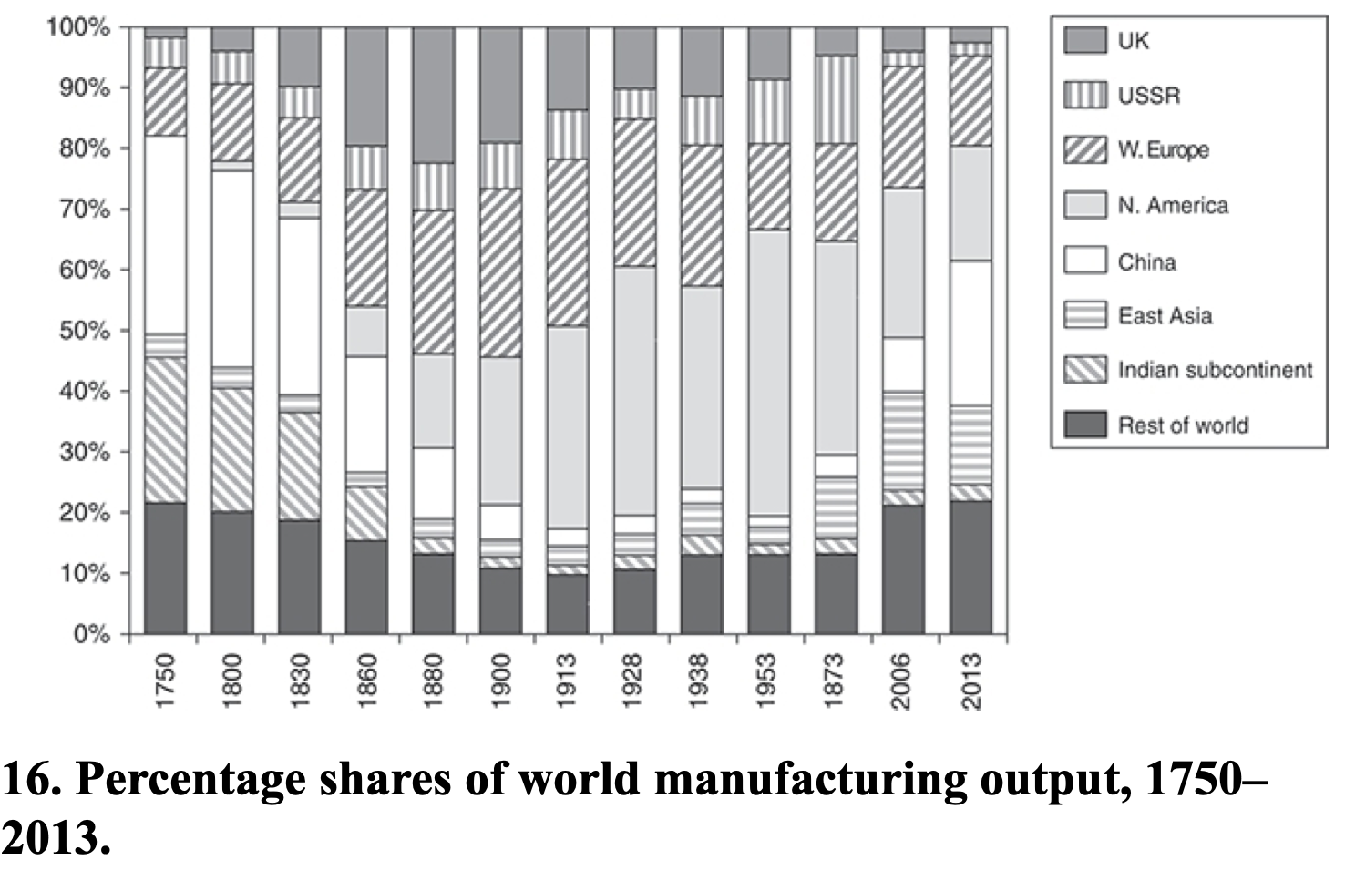
Allen: Spread of Industrialization
Robert Allen (2017): The Industrial Revolution: A Very Short Introduction <https://delong.typepad.com/files/allen-industrial.pdf>, chs. 3, 5-6:
Western Europe: 12% in the 18th century to 28% in 1913
North America: Less than 1% in the 18th century to 47% in 1953
The Pacific Rim share dropped from 4 per cent to 2 per cent in the early 19th century, but then increased to 5 percent in the first half of the 20th century. By 2006, these countries were producing 17 per cent of the world’s manufactures
China in 1953 at 2% of manufacturing was at its all time low. 9 per cent in 2006. 25 per cent in 2013
The Indian subcontinent: 2% of the world’s manufactures in 1973 and only 3% in 2013

Slide 43
Big Ideas: Lecture 18: Touring the Continents: Western Europe, South America, & North America
Takeaways from this class:

Slide 44
Catch Our Breath…
Ask a couple of questions?
Make a couple of comments?
Any more readings to recommend?

Slide 45

Notes, etc.…

